Slide 1

MIS571 Business Analytics Software and Applications II Class 1– Course Overview
Haoran Zheng PhD

Slide 2
Agenda for the day
Introductions
Syllabus
Forums for Questions
Discuss Class Project
Discuss RapidMiner

Slide 3
About me
Name: Haoran(Shawn) Zheng
Email: hzheng@fsmail.bradley.edu
Office: BECC 3148
Office Hours: In-person: By appointment only.
Virtual: W 12:00 PM – 1:00 PM

Slide 4
About you
Name
Declared major
What are you hopping to learn in this class
How many statistic courses have you taken?
Excel proficiency

Slide 5
Syllabus
Refer to the syllabus document posted on Canvas

Slide 6

Forums for Questions
Refer to Canvas

Slide 7

Class Project
Refer to Canvas

Slide 8

RapidMiner
Refer to Canvas

Slide 9

Why Business Analytics?

Slide 10


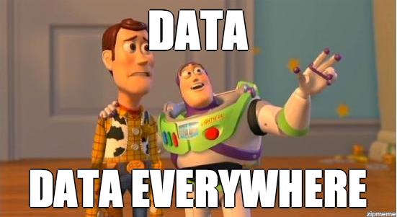
e-mail
Social networks
Web
Surveys
Call center
Corporate data
Online review sites

Slide 11
The Problem With Data
Most companies have plenty of data, but data is not information
Data is often spread across multiple systems, stored in different formats, and may even be localized for different countries
The first challenge is to consolidate the data so that it is consistent and accessible
Notes:
Many companies have more than enough data. In fact, a survey by the Gartner Group showed that most companies are doubling the amount of data they have stored every 18 months. High tech companies are doubling the amount of data they have stored at an even faster rate, sometimes in as little as 9 months. Therefore, organizations have a tremendous amount of data. There’s an old IT adage, however, that data is not information. This is true, as data must be put into the proper context and be easily accessible before it become usable.
Not only is there a tremendous amount of data, it is often stored in many different systems. Most organizations run multiple vertical applications: one for HR and payroll, one for accounting, one for inventory, and so forth. These applications may be on separate physical platforms and use different database engines to store data. Some of the data might even be localized for different countries, meaning that currency values are stored in the local currency.
Given this wealth of data and the fact that it is often distributed, the first challenge is simply collecting the data from the disparate sources and consolidating it so that it is easily accessible. Then the data must be made consistent so that all values are meaningful; for example, in order to compare sales form different countries, all the currency values must be converted into a single, common currency. This consolidated and consistent data must be stored in such a way that users can easily access it and perform analysis against it.

Slide 12
The Origins and Drivers of Business Analytics
Organizations are being compelled to capture, understand, and harness their data to support decision making in order to improve business operations
Managers need the right information at the right time and in the right place
“In God we trust…all others bring data” Edwards Deming

Slide 13

Three Principles of Real Estate

Slide 14

What Is the Business Problem/Opportunity?
Notes:
As an example, Fidelity Investments once considered discontinuing its bill-paying service because this service consistently lost money. Some last-minute analysis saved it, by showing that Fidelity’s most loyal and most profitable customers used the service. Although it lost money, Fidelity made much more money on these customers’ other accounts

Slide 15

To Serve or Not to Serve?
Fidelity Investments
Notes:
As an example, Fidelity Investments once considered discontinuing its bill-paying service Some last-minute analysis saved it, by showing that Fidelity’s most loyal and most profitable customers used the service. Although it lost money, Fidelity made much more money on these customers’ other accounts

Slide 16

To Serve or Not to Serve?
Cutting such value-added services might inadvertently exacerbate the profitability problem by causing the best customers to look elsewhere for better service.

Slide 17

What Is the Business Problem/Opportunity?
Should Fidelity Investments consider discontinuing its bill-paying service because this service consistently lost money?
Should the investment company encourage customers to switch to alternative methods of bill-paying?

Slide 18
Business Analytics
Use of data for fact-based management.
Data-driven decision-making. Data drives decisions and actions.
Adapted from: Davenport and Harris (2007) Competing on Analytics: The New Science of Winning

Slide 19
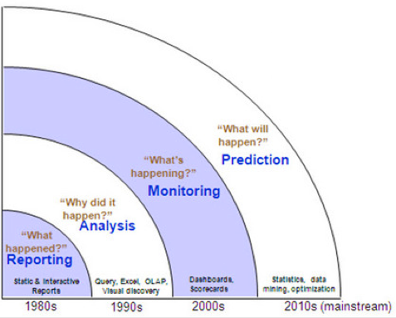
So… Why BA?
Competitive Advantage (understand the difference between data-driven decision-making vs. gut-feeling decision-making.
“In God we trust…all others bring data” Edward Deming
Innovation: new products, new services
Improve product or market fit
Understand who your customer is
Understand your customer needs

Slide 20
Still not convinced?
What if I tell you…

Slide 21

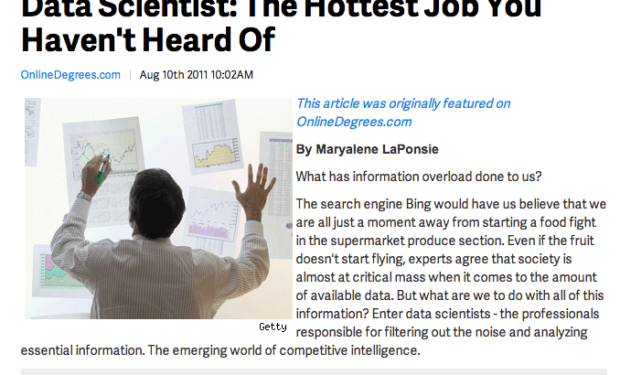
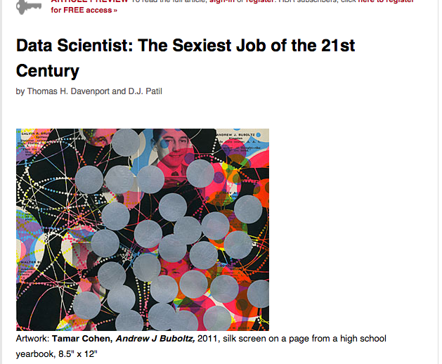
Analytics is fire !

Slide 22
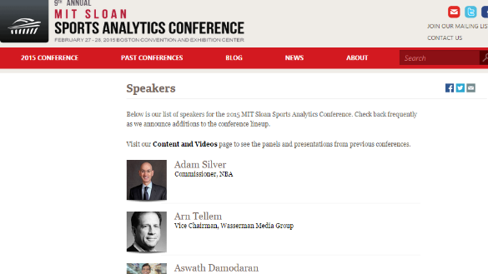
MIT Sloan Sports Analytics Conference (SSAC)
9th Annual Conference, February 27-28, 2015
Panels
Research track
Fast growth – 3100 attendees, 1800 on waitlist

Slide 23
More Applications:
Financial Services
Detect Fraudulent Transactions
Marketing (e.g. cross-sell; up-sell)
Pricing
Credit & Risk analysis
Healthcare
Any others you can think of?

Slide 24
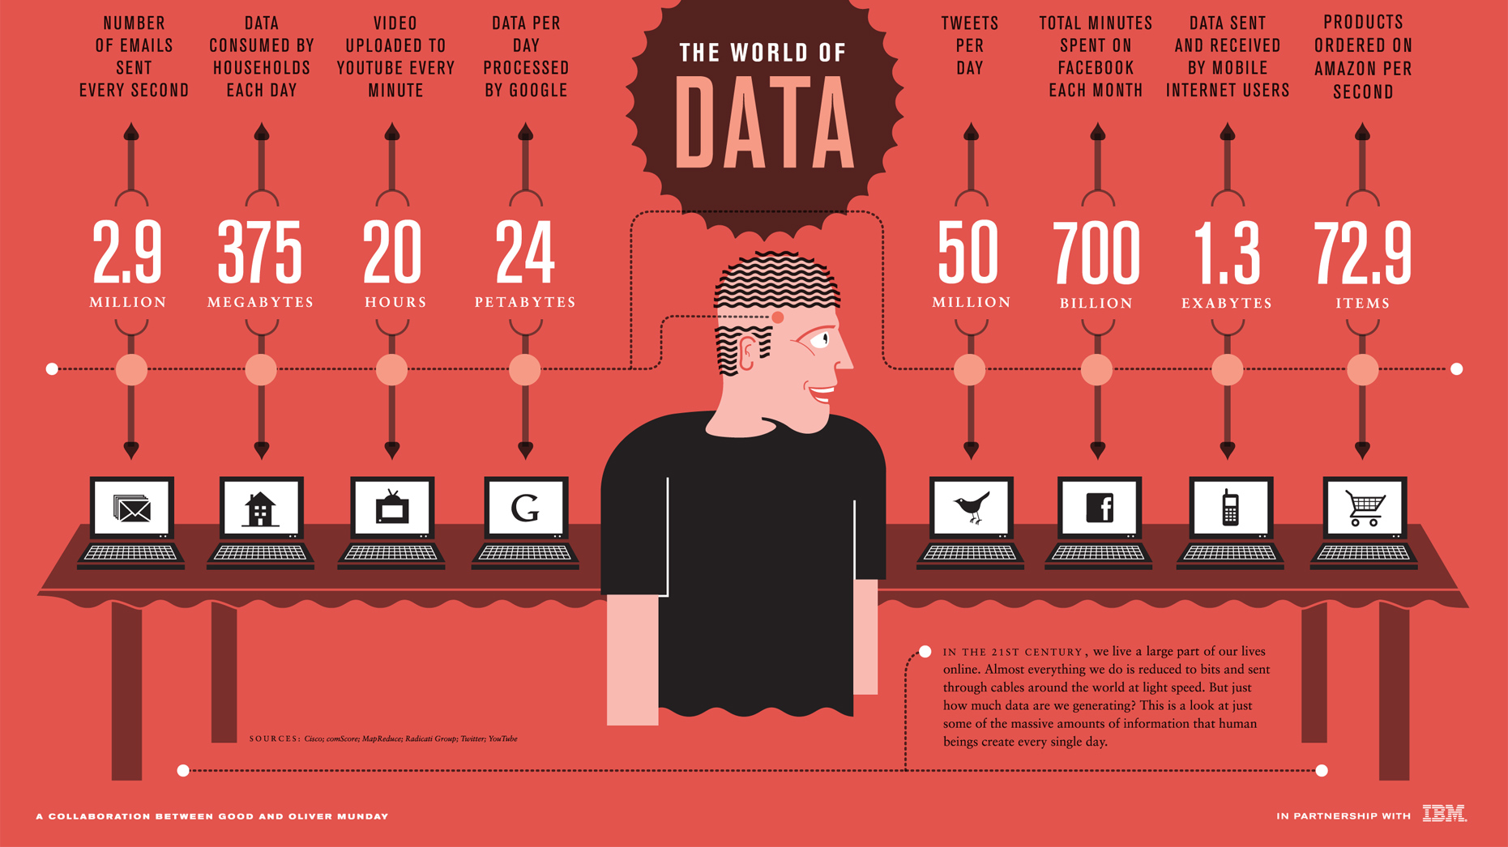
The Data Deluge
Source: The World of Data.

Slide 25
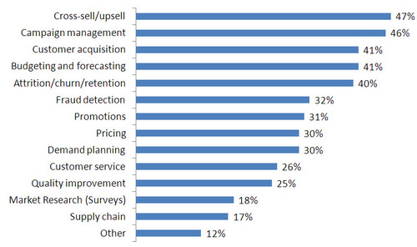
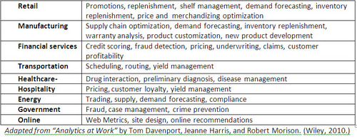
BA – Applications – Detailed
Source: BeyeNetwork Blog Blog: Wayne Eckerson

Slide 26
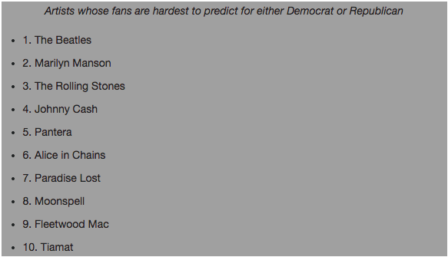
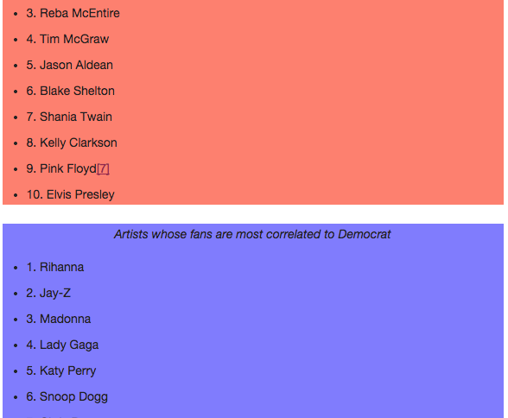
Advertising?
Geo-location for mobile ads (e.g. promotions)
Facebook connect
Predictive modeling based on music taste (e.g. Pandora)
“How well does music predict your politics?” –Brian Whitman

Slide 27
Predictive Analytics at Target
The classic example

Slide 28
Big picture: Do not miss the forest for the trees
Decision Optimization What is the best decision?
Advanced Analytics
Predictive Modeling What will happen next?
Competitive Advantage
Forecasting What if these trends continue?
Basic Statistical Analysis Why is this happening?
Basic
Analytics
Reporting with Early Warning What actions are needed?
Dynamic Reporting Where exactly are the problems?
Ad Hoc Reporting How many, how often, where?
Reporting
Basic Reporting What happened?
Data
Information
Intelligence
Decision Support
Decision Guidance

Slide 29

Simple Reporting
Examples: OLAP, RFM, QC, descriptive statistics
Answer questions such as
Where are my key indicators now?
Where were my key indicators last week?
Is the current process behaving like normal?
What is likely to happen tomorrow?

Slide 30
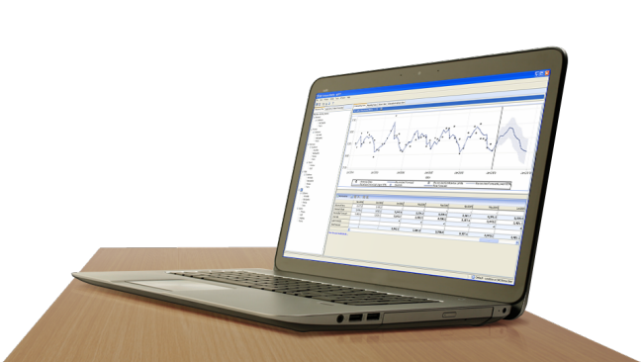
Proactive Analytical Investigation
Examples: inferential statistics, experimentation, empirical validation, forecasting, optimization
Answer questions such as
What is the best combination of factors to give me the most efficient use of resources and maximum profitability?
What is the highest price the market will tolerate?
What will happen in six months if I do nothing? What if I implement an alternative strategy?
Notes:
Based very loosely on Davenport, et al. 2010 pp 6-7

Slide 31
Machine Learning: Supervised vs. Unsupervised Learning
Supervised Learning (Estimation and Classification)
The training data contains target class information for each record (e.g. spam, churn).
New records are classified based on the models developed on the training data (e.g. scoring).
Unsupervised Learning (Clustering)
The classification of the training data is unknown.
The aim is to construct a set of clusters, given the data.

Slide 32

Data Mining Tasks: Supervised
Classification
Yes/No Decisions, or multi-value discrete decisions
Estimation
Continuous value output

Slide 33

Supervised Learning Techniques
Linear/Logistic Regression
Neural Networks
Bayesian Statistics
Decision Trees

Slide 34

Data Mining Tasks: Unsupervised
Segmentation or Clustering
What type of drugs give bad reactions to female heart patients
What type of products sell well to female customers
Summarization/Rules
What combination of drugs are prescribed to heart patients
What health indicators tend to co-exist in diabetes patients

Slide 35

Unsupervised Techniques
Clustering
Association Rule Mining and Market Basket Analysis

Slide 36
Business Problems for Data Mining
Churn Analysis
Which customer is most likely to go to a competitor?
Cross-selling
What products are customers likely to purchase?

Slide 37
Business Problems for Data Mining
Targeted ads
What banner ads should be displayed to a specific customer? (e.g. Pandora)
Customer Segmentation
Who are my customers?
Who are my students?

Slide 38

Business Problems for Data Mining
Fraud Detection
Is this insurance claim fraudulent?
Risk Management
Should the loan be approved for this customer?
Tang/MacLennan (2005)

Slide 39
